Slide 1


Python Flask - Demo

Slide 2
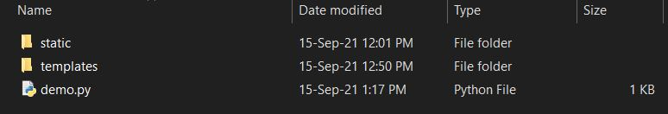
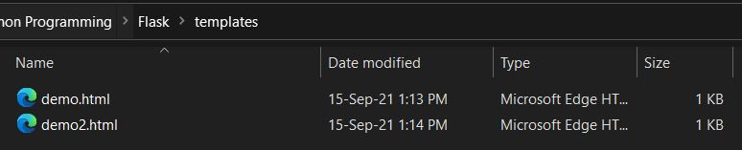
Flask
Install Flask <pip install flask>
Create a python file
Create a folder <templates > --> Holds html files
Create a folder <static> --> Holds image files

Slide 3
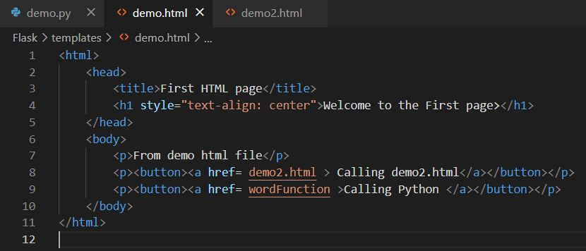
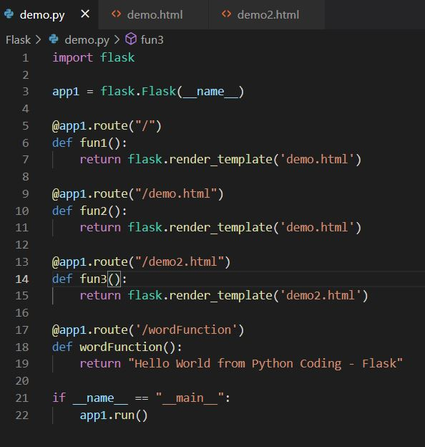
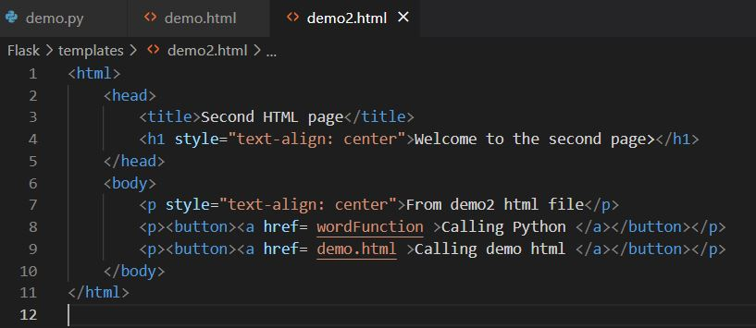
Snippets

Slide 4
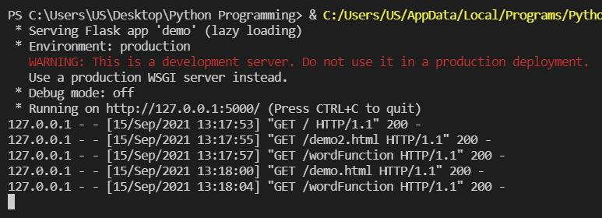
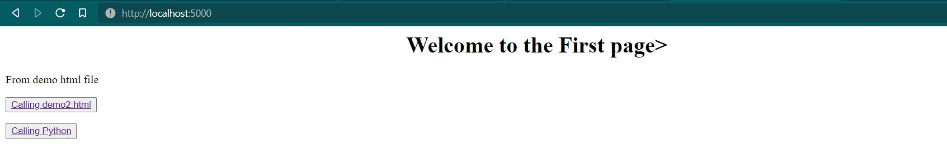
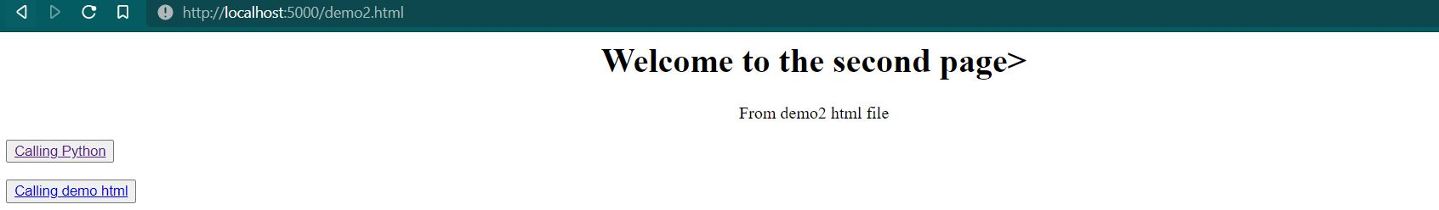
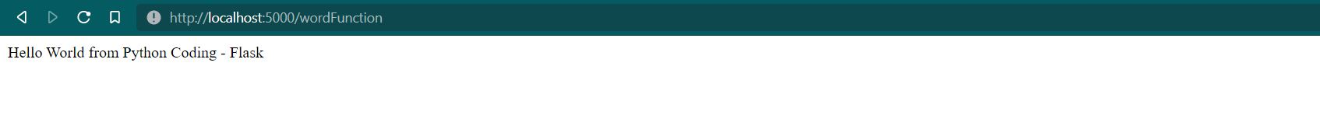
Output:
Terminal View -->
Line 5 : @app1.route("\")
demo.html file loaded
Line 13 : @app1.route("demo2.html")
demo2.html file loaded
Line 9 : @app1.route("demo.html")
demo.html file loaded
Line 17 : @app1.route("wordFunction")

